Slide 1
Floating Content in Vehicular Ad-hoc Networks
Gaetano Manzo, Ph.D. Student
Annual meeting Bern 21/07/2017
University of Bern & University of Applied Sciences Western Switzerland

Slide 2
Storyboard
Floating Content in VANETs
Random Waypoint to model FC
(ITC)
Anchor Zone reshape for saving resources
(MobiWorld)
Past work
Hybrid scenario
Several vehicular traces
Machine Learning approach
Present / Future

Slide 3
Floating Content (FC) is a possible solution to lead the information spreading in the vehicular environment.

Slide 4
Anchor Zone
Opportunistic
communication
Mobility model
Application
Information geographically constrained
No infrastructure support needs
FC is a possible solution!
Suitable for vehicular and pedestrian scenario
Attractive for
Advertisement
Safety
. . .
SLOW DOWN !

Slide 5
Floating Content
Basic Functionalities

Slide 6
Content generation
Content spreading
Content
erasing
Node = =
or
node without the content
node with the content
node deleting the content

Slide 7
Random waypoint has been used to model FC in vehicular scenario
G. Manzo, M. A. Marsan, and G. A. Rizzo, ”Performance modeling of vehicular Floating content in urban setting” - ITC Conference 2017.

Slide 8
We define the “District Model” to characterize the AZ
It is not our concern to model the world outside the AZ
Within AZ:
District Model
Outside AZ:
Arbitrary Mobility
Arbitrary Mobility
Arbitrary Mobility
Arbitrary Mobility

Slide 9
The District Model is an extension of the RWP Mobility Model
exit
enter
RWP
Assumption: all pdf are the same!
Within the AZ nodes move (Tmove) according to RWP with pause (Tstop)
waypoint

Slide 10
Our process is easy!
System performance
Study of an epoch
Assumptions
Success probability
Node uniform distributed
Poisson arrival time
Availability
Tmove
Tstop
No border effect
Floating Content
No clustering

Slide 11
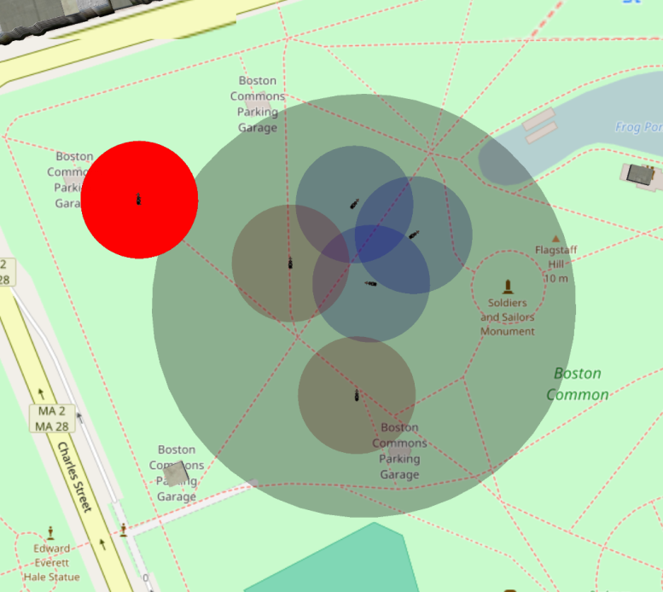
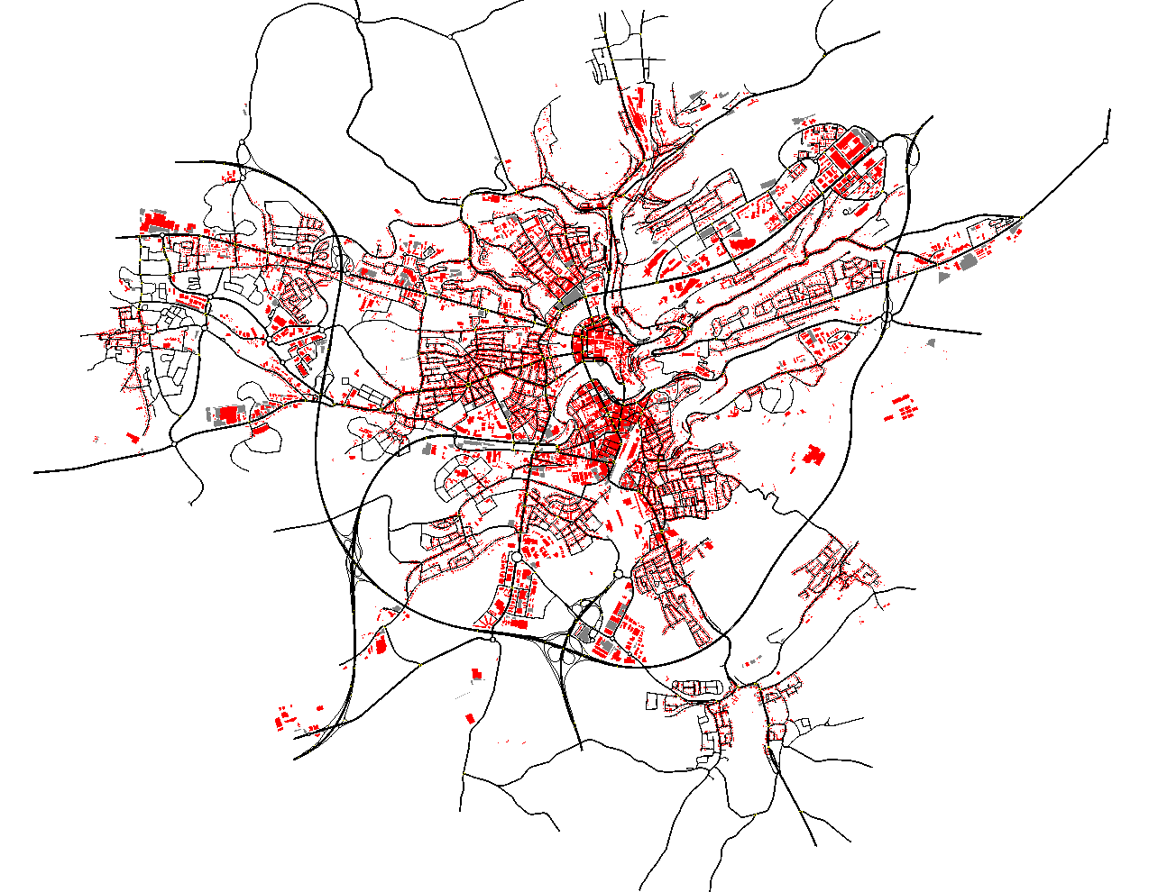
Numerical evaluation has been done in ad-hoc and real scenario
Ad-hoc simulation to assess the analytical part
Model evaluated on vehicular environment
1000m

Slide 12
The high correlation between model and ad-hoc simulation shows the marginal impact of the assumptions made

Slide 13
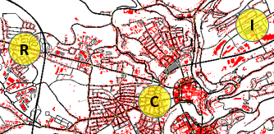
The success probability is strongly correlated with the mobility within the AZ
District: Residential; City center; Industrial.

Slide 14
If the content does NOT float the success probability is a useless perfomace parameter!

Slide 15
Floating<2 min
Low density
Sojourn time, node density are the principal parameters
Floating<40 min
High density, short sojourn time
Floating>2 hours Medium density, long sojourn time
Low traffic time data:
R
DISTRICT
C
DISTRICT
I
DISTRICT

Slide 16
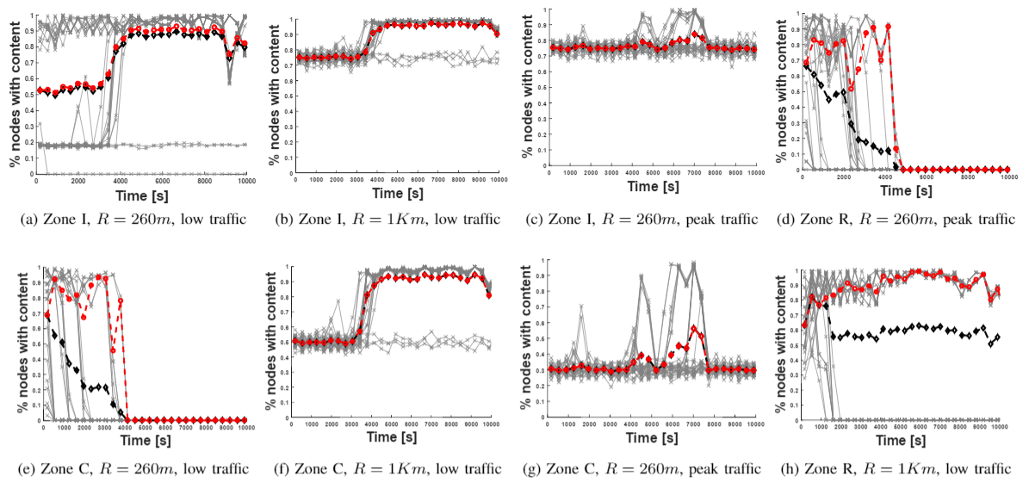

Slide 17
Floating Content modelization Future work

Slide 18
The next step of this work is simulate several scenarios
Hybrid :
Pedestrian & Vehicular
Several vehicular mobility trace
Manhattan
Cologne
Lux (several zones)
…
e.g., Bologna and Helsinki traces

Slide 19
Anchor Zone dimensioning is still an open challenge
G. Manzo, R. Soua, A. Di Maio, T. Engel, M. R. Palattella, and G. Rizzo, ” Coordination Mechanisms for Floating Content in Realistic Vehicular Scenario” - MobiWorld 2017, IEEE INFOCOM.

Slide 20
By leading the Anchor Zone radius is possible to control the number of nodes involved in the communication.

Slide 21
There are several performance parameters to optimaze in order to save resources
Find the minimum AZ radius which respect the success probability desired
#nodes with content
#nodes exiting with content
Content lifetime
Time to get the content

Slide 22
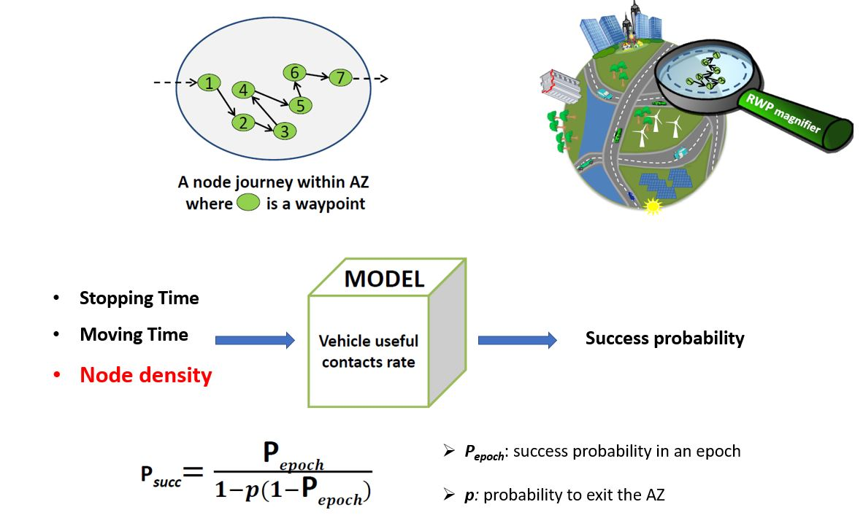
FC performance is modelled by the RWP mobility model to evaluate the minimum radius

Slide 23
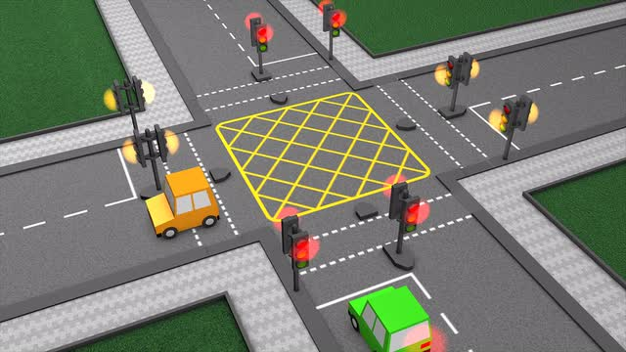
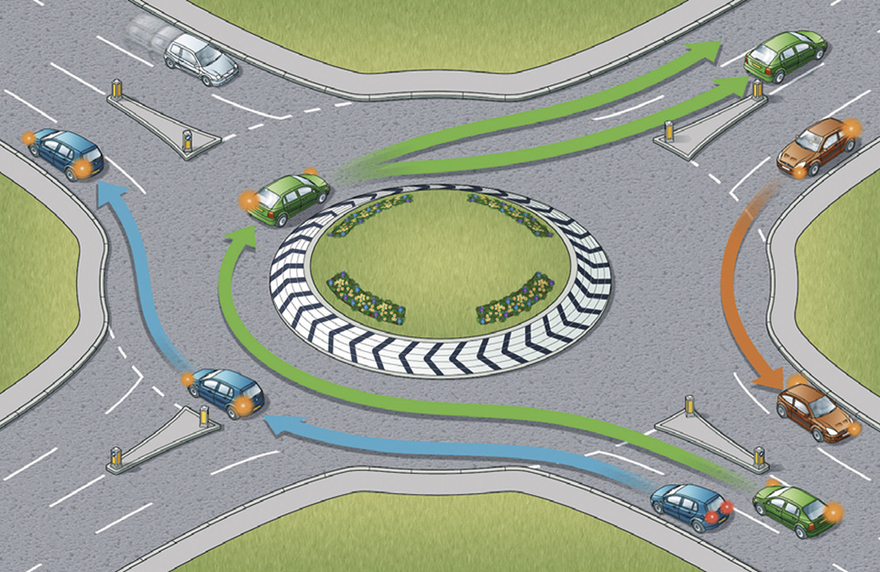
The estimation of vehicular density parameter is required as input for the chosen mobility model
By the city map: Tstop and Tmove
Two different approaches to estimate node density:
Centralized: infrastructure-supported
Distributed: infrastructure-less

Slide 24
Infrastructures support node density estimation in the centralized approach

Slide 25
The distributed approach is used for infrastructure-less situation
SECTOR
SECTOR

Slide 26
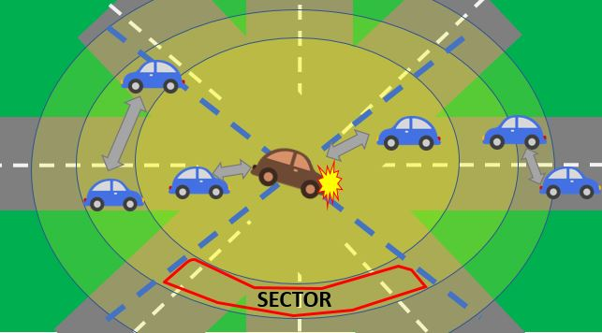
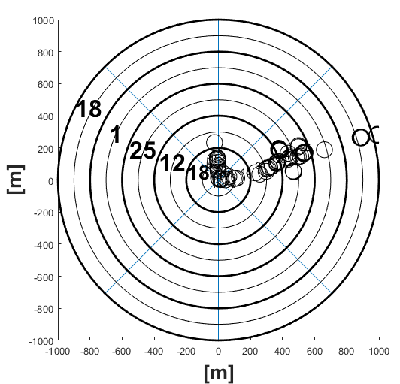
The estimation has to be computed by vehicles, possible in a cooperative way
More sectors the higher is the quality of the estimation

Slide 27
The choice of the number of the sectors to estimate node density is a thread-off between accuracy and payload.
The right number of sectors is not trivial choice

Slide 28
Simulation Setting
Tstop 15s, Tmove 25s
AZ placed in C
Node TX range radius 100m
Simulation time:
3h for low-traffic (4am-6am)
and high-traffic (7am-9am)

Slide 29
Unlike peak traffic time, the simulation results during low traffic show a stable node arrival rate
Low Traffic
Peak Traffic
From node density to arrival rate by the Little’s Law

Slide 30
Success probability for both approaches during low and peak time traffic reflects the node density estimation
Low Traffic
Peak Traffic

Slide 31
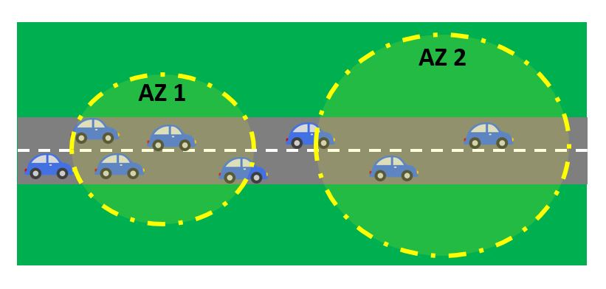
The increasing of AZ radius does not necessarily involve a higher success probability
Model uniform node density.
Not including traffic zone, success probability does not raise

Slide 32
A machine learning approach for FC Future work

Slide 33
The aim is the same of the previous work but the approach is not model-based
Previous Work:
INPUT
Output
MODEL
OPTIMIZATION
Future Work:
Features &
App. requirement
Output
Given by the DATA

Slide 34
The first step is to select the features (system input)
Mobility & Network Features:
Mean time moving and static (Tmove, Tstop)
Mean arrival rate (lambda)
Node transmission range (r)
Mean speed (v)
Sojourn time (Tsoj)
Application requirement:
The training set is a table with all the features + success probability + AZ radius
Minimum Anchor Zone radius (Rmin)
Maximum Anchor Zone radius (Rmax)
Target Success Probability (TPsucc )
Training set :
Tmove Tstop lambda r v Tsoj R Psucc

Slide 35
The second step is to train our model
Training set :
Tmove Tstop lambda r v Tsoj R Psucc
INPUT
Learning Algorithms
Feature 2
Feature n
Feature 1

Slide 36
The last step is to TEST our model
Features set :
Cost function set :
Tmove Tstop lambda r v Tsoj
TPsucc Rmin Rmax
INPUT
Learning Algorithms
Feature 2
Feature n
Feature 1
R that respect the application requirement

Slide 37
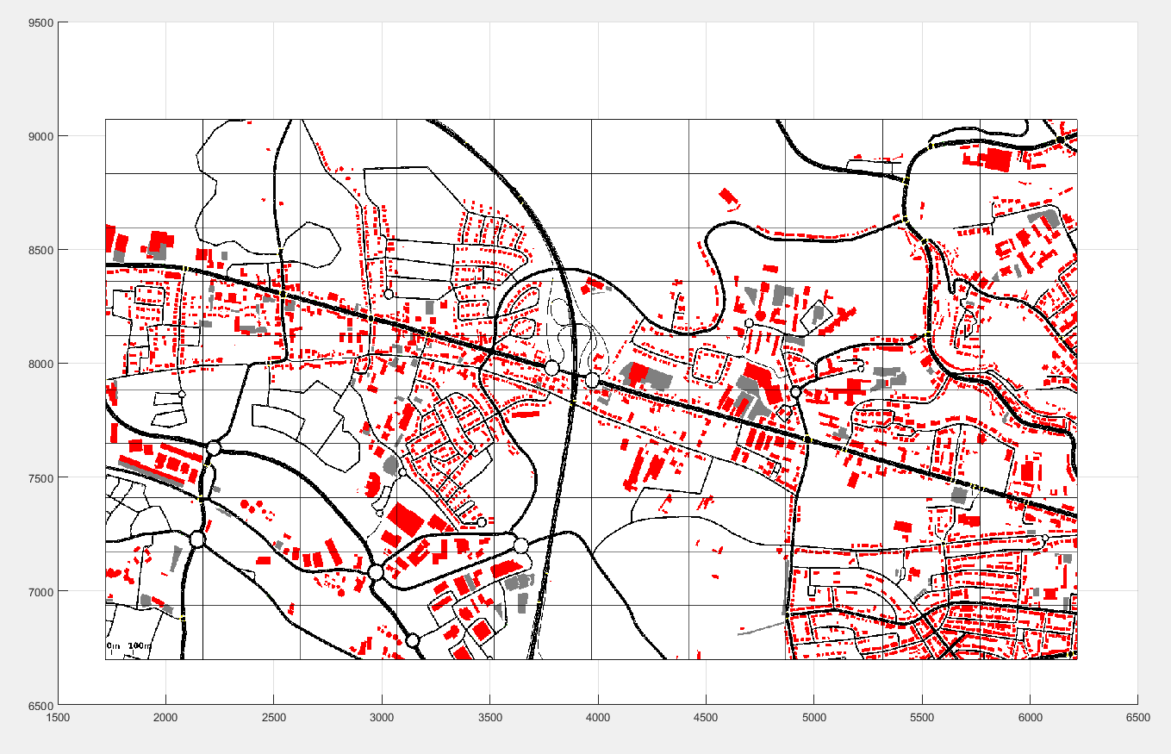
Spreading limitation in LUX city
using a grid

Slide 38
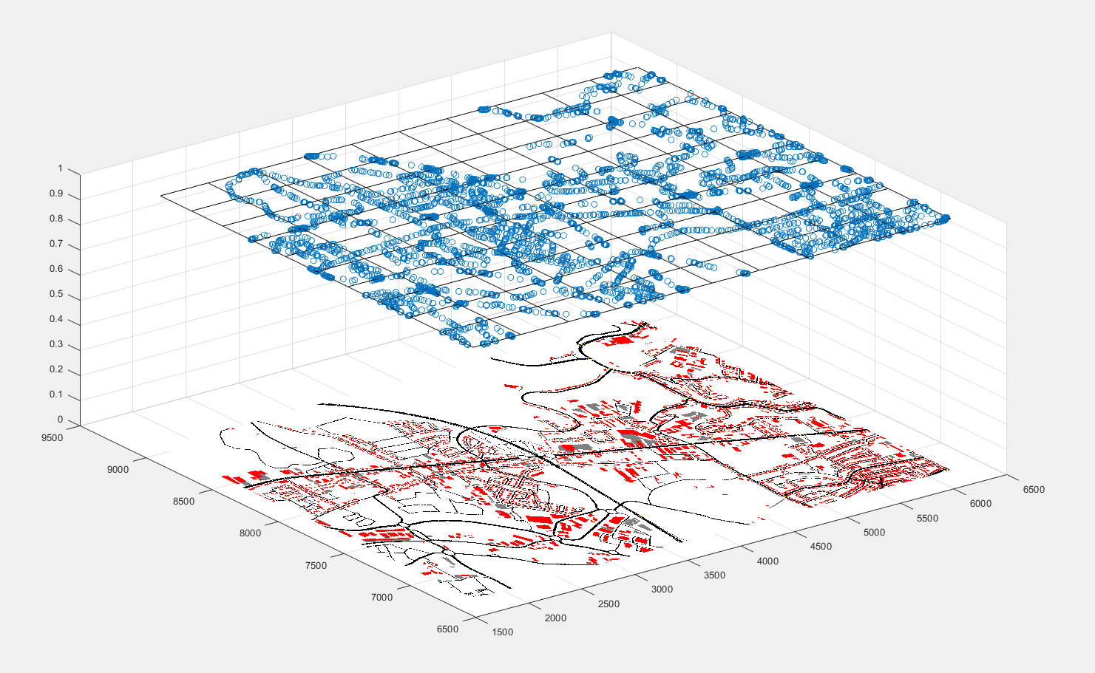
Spreading limitation in LUX city
using a grid

Slide 39
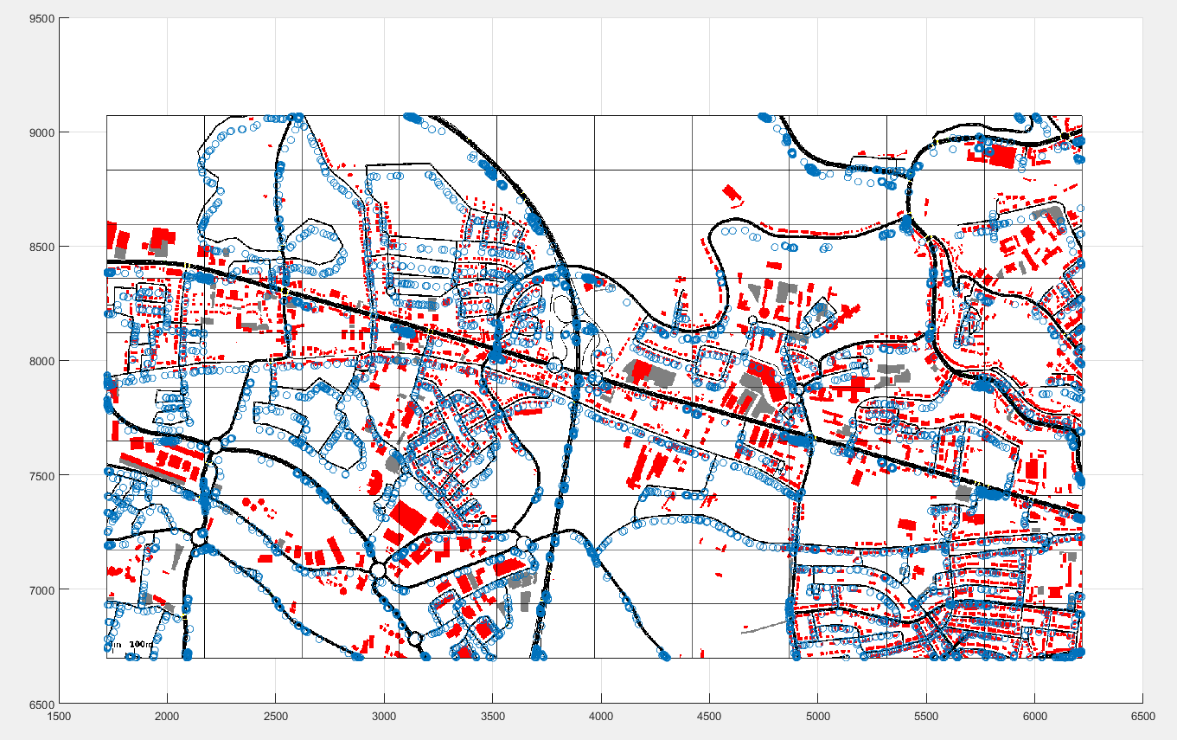
Spreading limitation in LUX city
using a grid

Slide 40
Things to do
Confirm the features and training set
Cross correlation
Choose the way to extract the training set
Choose machine learning technique
Test the machine with real data traffic e.g., LUX trace

Slide 41
Thank you

